Slide 1


Presentation on Micro Credit Defaulter Project
Presented by:-
Arpan Pattanayak

Slide 2
Introduction
Loans of value 6 & 12 rupees are provided by our client (telecom operator) in collaboration with a Microfinance Institute (MFI).
High return (20% return within 5 days) as well as High risk venture (high risk of default as loan is being provided to low income populations)
Objective is to study the behaviour of defaulters as well as prepare a machine learning model to classify all defaulters using the sample dataset provided by the client
We’ll also test multiple classifier algorithms with multiple evaluation metrics and select the best model based on proper metric, perform GridSearchCV for best parameter settings

Slide 3
Problem Statement
A client in Indonesian Telecom Industry is collaborating with a Microfinance Institution (MFI) to provide micro-credit on mobile balances to be paid back in 5 days. The Consumer is believed to be defaulter if he deviates from the path of paying back the loaned amount within the time duration of 5 days. In order to improve the selection of customers for the credit, the client wants some predictions that could help them in further investment and improvement in selection of customers.
In this project we need to build a model which can be used to predict in terms of a probability for each loan transaction, whether the customer will be paying back the loaned amount within 5 days of insurance of loan. In this case, Label ‘1’ indicates that the loan has been paid i.e., “non-defaulter”, while Label ‘0’ indicates that the loan has not been paid i.e., “defaulter”.

Slide 4
Dataset and Features
The dataset contains default status of users along with associated features.
Let’s also look into what the distribution of a feature means as well as how these features relates with loan defaults

Slide 5
Description of Features
S. No | Variable | Definition
1 | label | Flag indicating whether the user paid back the credit amount within 5 days of issuing the loan{1:success, 0:failure}
2 | msisdn | mobile number of user
3 | aon | age on cellular network in days
4 | daily_decr30 | Daily amount spent from main account, averaged over last 30 days (in Indonesian Rupiah)
5 | daily_decr90 | Daily amount spent from main account, averaged over last 90 days (in Indonesian Rupiah)
6 | rental30 | Average main account balance over last 30 days
7 | rental90 | Average main account balance over last 90 days
8 | last_rech_date_ma | Number of days till last recharge of main account
9 | last_rech_date_da | Number of days till last recharge of data account
10 | last_rech_amt_ma | Amount of last recharge of main account (in Indonesian Rupiah)
11 | cnt_ma_rech30 | Number of times main account got recharged in last 30 days
12 | fr_ma_rech30 | Frequency of main account recharged in last 30 days

Slide 6
S. No | Variable | Definition
13 | sumamnt_ma_rech30 | Total amount of recharge in main account over last 30 days (in Indonesian Rupiah)
14 | medianamnt_ma_rech30 | Median of amount of recharges done in main account over last 30 days at user level (in Indonesian Rupiah)
15 | medianmarechprebal30 | Median of main account balance just before recharge in last 30 days at user level (in Indonesian Rupiah)
16 | cnt_ma_rech90 | Number of times main account got recharged in last 90 days
17 | fr_ma_rech90 | Frequency of main account recharged in last 90 days
18 | sumamnt_ma_rech90 | Total amount of recharge in main account over last 90 days (in Indonesian Rupiah)
19 | medianamnt_ma_rech90 | Median of amount of recharges done in main account over last 90 days at user level (in Indonesian Rupiah)
20 | medianmarechprebal90 | Median of main account balance just before recharge in last 90 days at user level (in Indonesian Rupiah)
21 | cnt_da_rech30 | Number of times data account got recharged in last 30 days
22 | fr_da_rech30 | Frequency of data account recharged in last 30 days
23 | cnt_da_rech90 | Number of times data account got recharged in last 90 days
24 | fr_da_rech90 | Frequency of data account recharged in last 90 days

Slide 7
S. No | Variable | Definition
25 | cnt_loans30 | Number of loans taken by user in last 30 days
26 | amnt_loans30 | Total amount of loans taken by user in last 30 days
27 | maxamnt_loans30 | maximum amount of loan taken by the user in last 30 days
28 | medianamnt_loans30 | Median of amounts of loan taken by the user in last 30 days
29 | cnt_loans90 | Number of loans taken by user in last 90 days
30 | amnt_loans90 | Total amount of loans taken by user in last 90 days
31 | maxamnt_loans90 | maximum amount of loan taken by the user in last 90 days
32 | medianamnt_loans90 | Median of amounts of loan taken by the user in last 90 days
33 | payback30 | Average payback time in days over last 30 days
34 | payback90 | Average payback time in days over last 90 days
35 | pcircle | telecom circle
36 | pdate | date

Slide 8
Data Analysis and Model Building Flowchart
Import Libraries
Import Dataset
Data Preprocessing
Data Balancing
Identifying Outliers and Skewness
Visualizations
(EDA)
Model Building
Hyperparameter Tuning
AUC-ROC Curve & Saving model

Slide 9
Exploratory Data Analysis
First I have imported the necessary libraries and loaded the entire dataset in our Jupyter Notebook and renamed the project file from untitled.
Then I checked the shape of our dataset and found that we have a total of 2,09,593 rows and 37 different columns.
We don’t have any null values or missing values present in our dataset.
Removed the unwanted column which doesn’t have much importance on prediction.
By checking the data types I came to know that our data set consists of columns have float, integer and object data type values.
Extracted Day, Month and Year features from pdate column.
Visualizing the features using univariate and bivariate analysis.
Shape : 2,09,593 rows and 37 columns
No null values present
Remove unwanted column
Datatypes of float, integer and object are in dataset

Slide 10
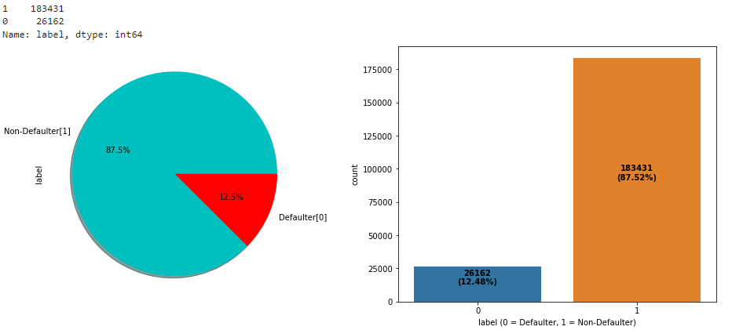
Visualizations: Univariate Analysis
Target Variable: Visualizing label whether the user paid back the credit amount within 5 days of issuing the loan or not {1:success, 0:failure}
From the above plots we can observe around 87.5% of the loan has been paid by the user and only 12.5% of the loan failed to pay. Also, the dataset is highly imbalanced, so we need to work on that or else our model will be more biased towards success and make false interpretation.

Slide 11
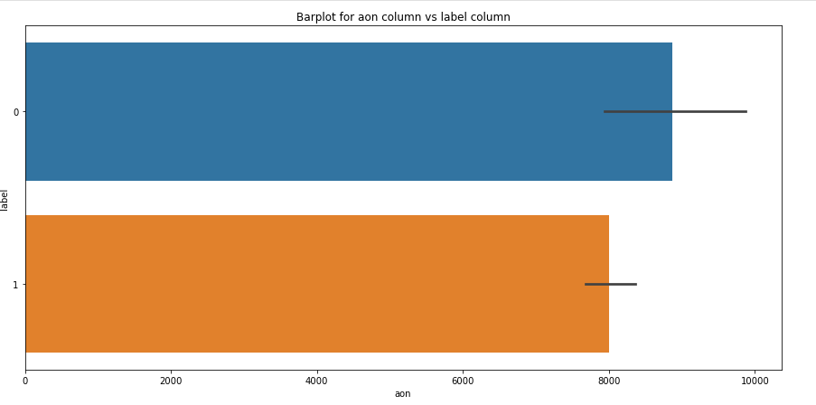
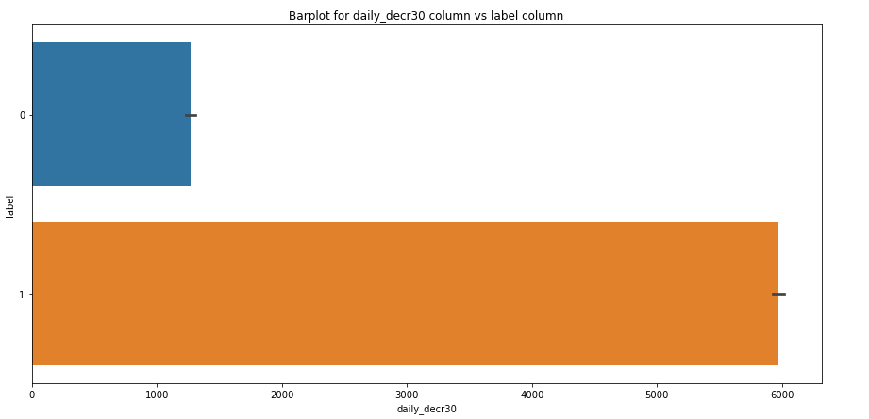
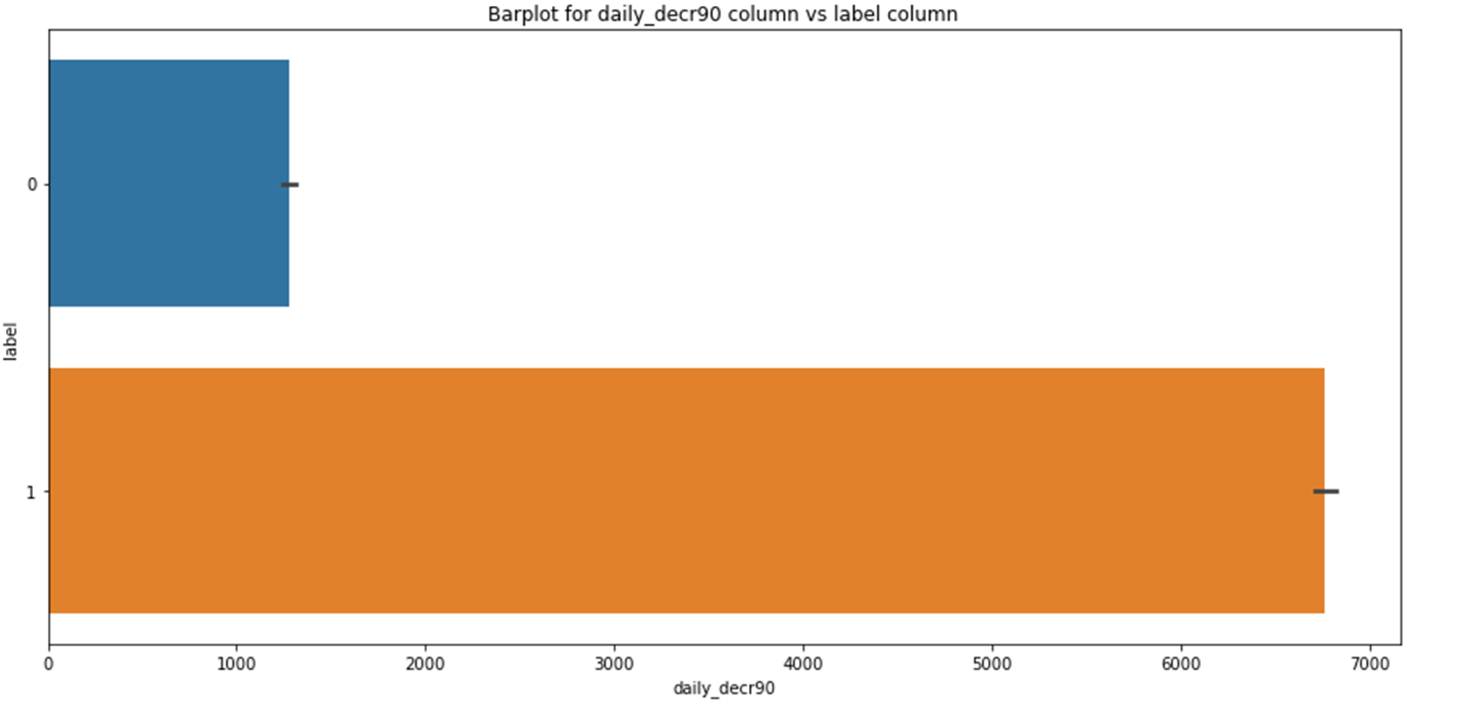
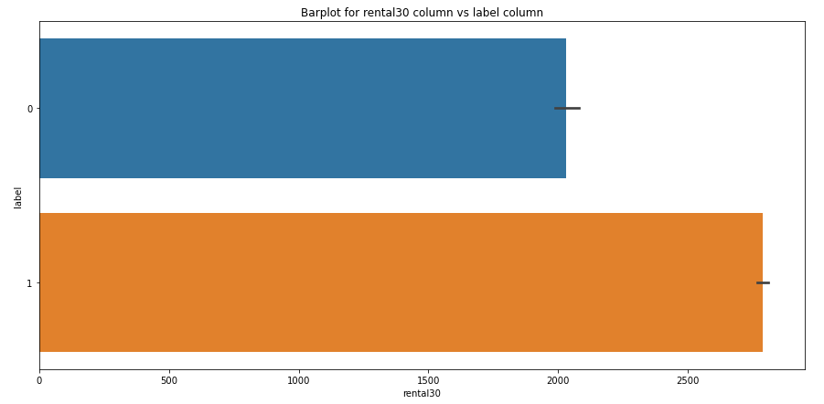
Visualizations: Bivariate Analysis
The users who have spent daily amount from main account over last 30 days and 90 days have always paid back the loan amount within 5 days. Around 0.6% of the users failed to pay back the loan within due date.
From the above bar plot we can observe that the defaulter rate is higher where the user age on cellular network in days is high which has around 8871 counts (in days).
Most of the users who have paid back the credit amount within 5 days of issuing loan, they have high rate of daily amount spent from the account over last 30 days and 90 days which have the count around 5940 and 6732 respectively.

Slide 12
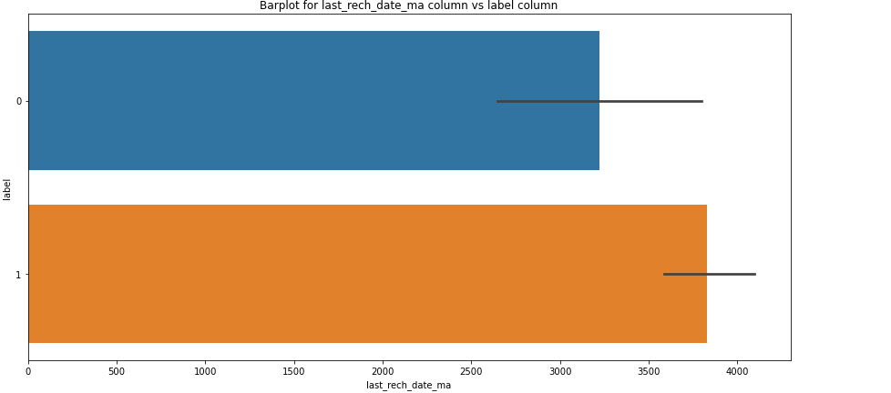
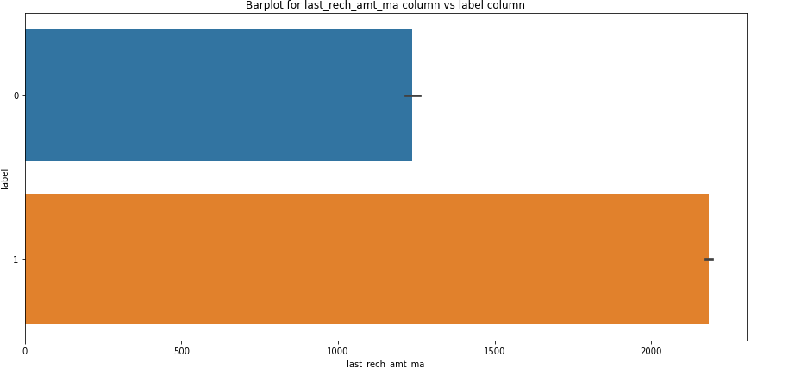
Visualizations: Bivariate Analysis
The users who have recharged their main account on time are most likely to pay back their loan amount within 5 days. Also, some of the users who have not paid back their loan within 5 days they also recharged their main account on time
Looking at above plot of last_rech_amt_ma, we can say that if the amount of last recharge of main account is around 2000 then a greater number of people will pay back the loan amount.

Slide 13
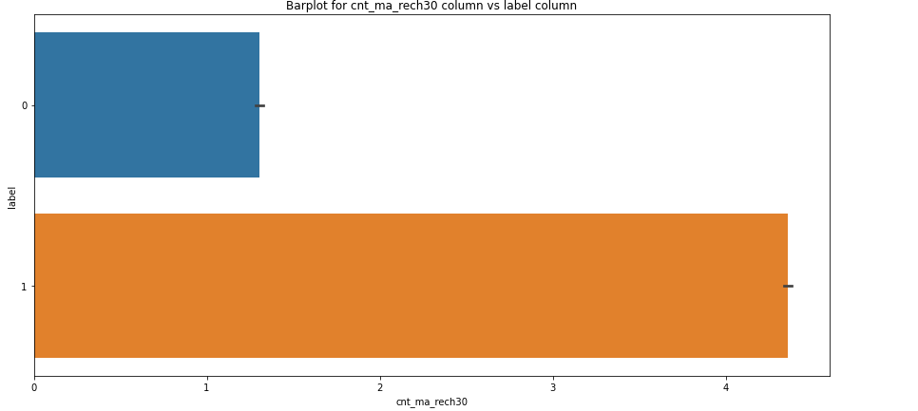
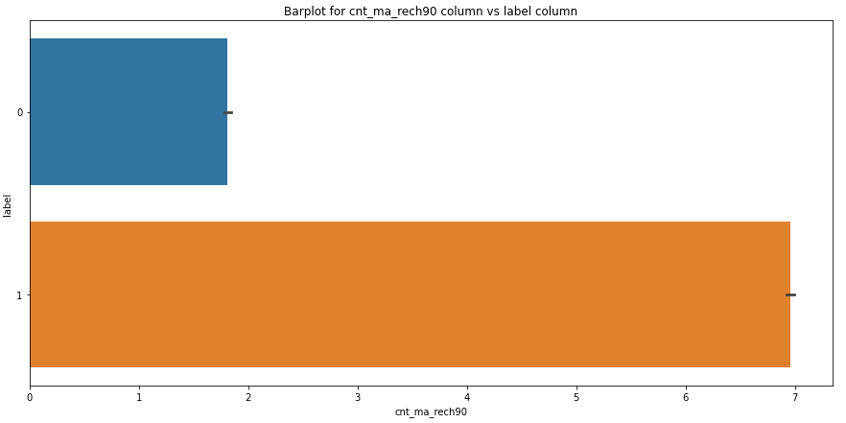
Visualizations: Bivariate Analysis
The users who have paid back their loan within 5 days have got recharged their main account upto 7 times in last 90 days and the users who have not been paid loan within due date, they have got recharged their main account twice in last 90 days.
From both the plots we can say that the users who got recharged their main account maximum times, they are able to pay back their loan amount within 5 days compared to the users who got their main account recharged less than 2 times.

Slide 14
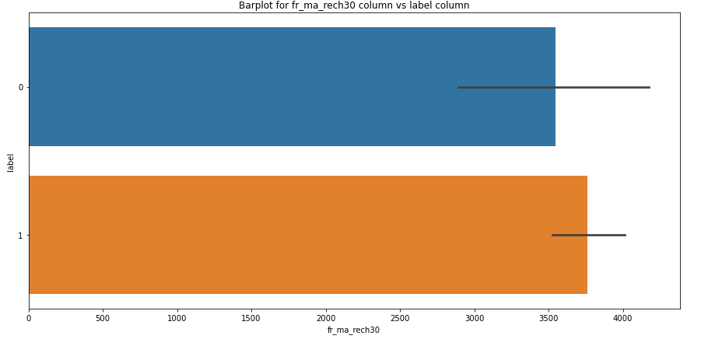
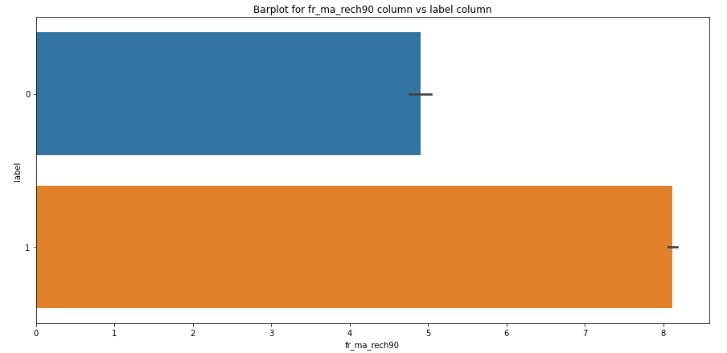
Visualizations: Bivariate Analysis
The count of defaulters and non-defaulters is almost similar for the frequency of main account recharged in last 30 days. They didn't pay back the loan within 5 days. Which means there it is not contributing more for prediction
The frequency of main account recharged in last 90 days is increased for non-defaulters compared to defaulters.
From the frequency of main account recharged in last 30 days & 90 days we have seen the users with low frequency are causing huge losses, company should implement strategies to reduce that like send SMS alerts for notification.

Slide 15
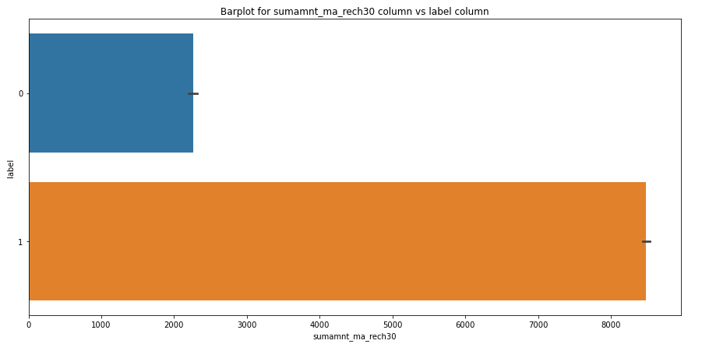
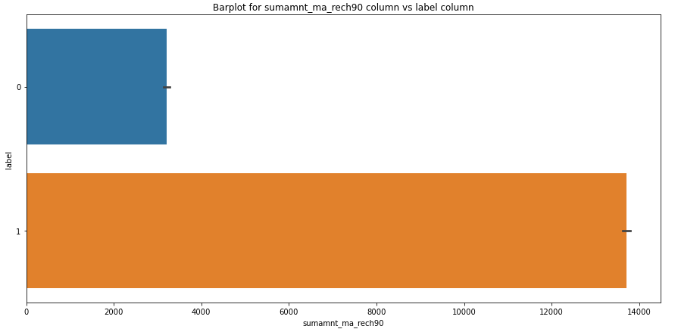
Visualizations: Bivariate Analysis
The users who failed to pay back the loan within 5 days have less amount of recharge in their main account over last 30 days which is around 2000-2400 (in Indonesian Rupiah). And the users who paid back their loan within 5 days, they are recharging their main account more than 8000 (in Indonesian Rupiah) in last 30 days.
The users who have paid their loan amount within 5 days have the total amount of recharge in their main account around 13700 (Indonesian Rupiah) in last 90 days while the defaulters have their total amount of recharge around 3500 (Indonesian Rupiah) over last 90 days.

Slide 16
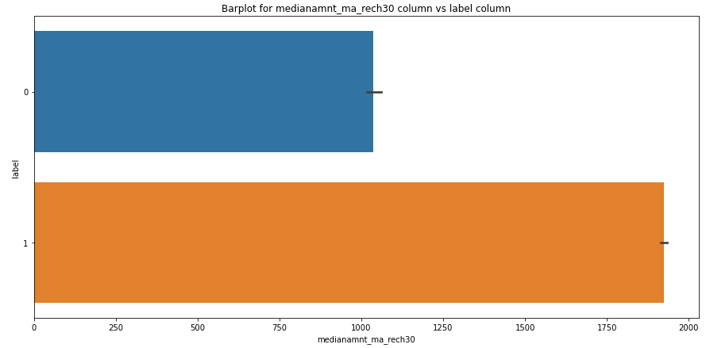
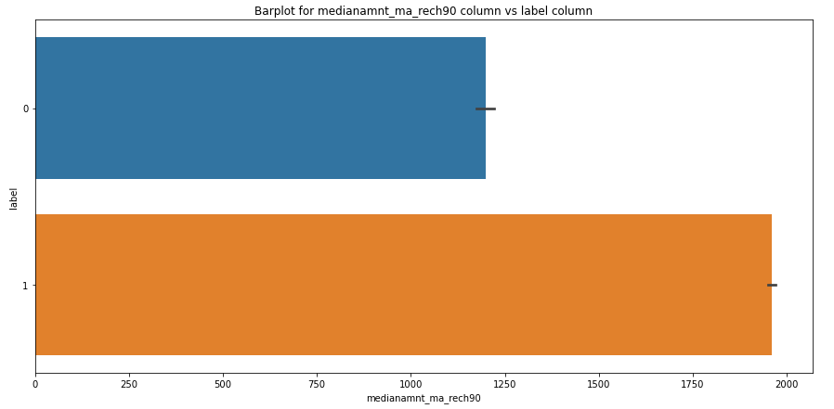
Visualizations: Bivariate Analysis
The users who have done their median amount of recharge of around 2000 in main account over last 30 days have successfully paid their credit amount within 5 days of issuing loan while the users who have done amount recharge of around 1000 have failed to pay back the loan within due date.
Similar to 30 days data, here also the users who have done their median amount recharge of 1950 in their main account over last 90 days they have paid back their credit amount within 5 days while the users having their median amount around 1200 have not paid the loan within 5 days
.

Slide 17
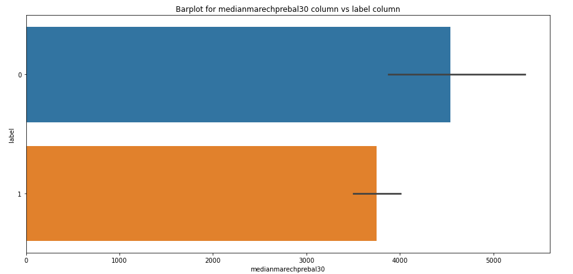
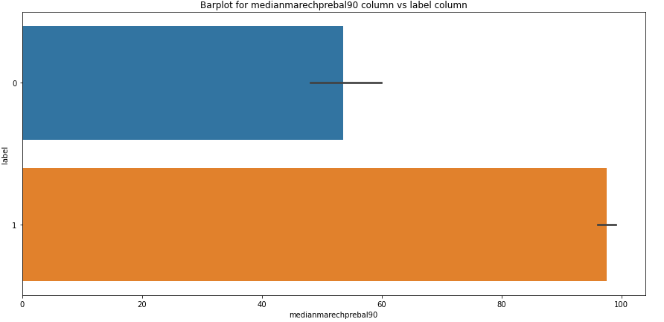
Visualizations: Bivariate Analysis
In 30 days, data, the median of main account balance for defaulters are around 4500 (Indonesian Rupiah) which is high compared to non-defaulters. Which means increasing median of main account balance just before recharge in last 30 days at user level, increasing the probability to being defaulter.
In last 90 days data, the median of main account balance for non-defaulters are around 100 (Indonesian Rupiah) which is high compared to defaulters. Which means increasing median of main account balance just before recharge in last 90 days at user level, increasing the probability of being non-defaulters.
.

Slide 18
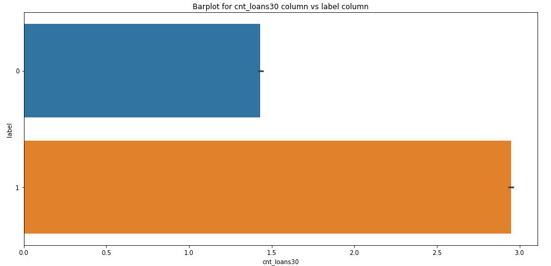
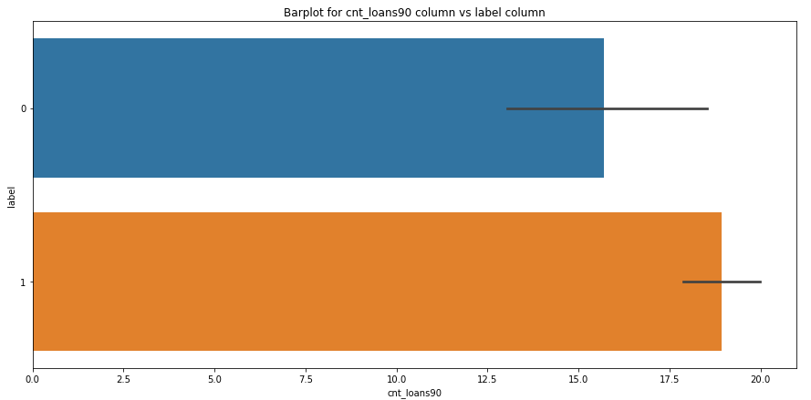
Visualizations: Bivariate Analysis
Defaulters have taken 1 loan in last 30 days that is when a person takes loan amount for 1 time in last 30 days the chances of not paying back the credit amount are higher. And the users who have paid back the loan, they have taken maximum number of 3 loans in last 30 days data.
In 90 days data, the number of loans taken by the defaulters are highly increasing also increasing the probability to being defaulter. Also, the number of loans taken by non-defaulters being decreased in last 90 days when compared to 30 days data.
.

Slide 19
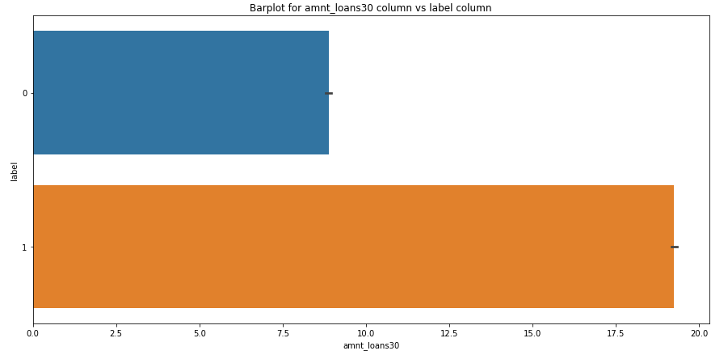
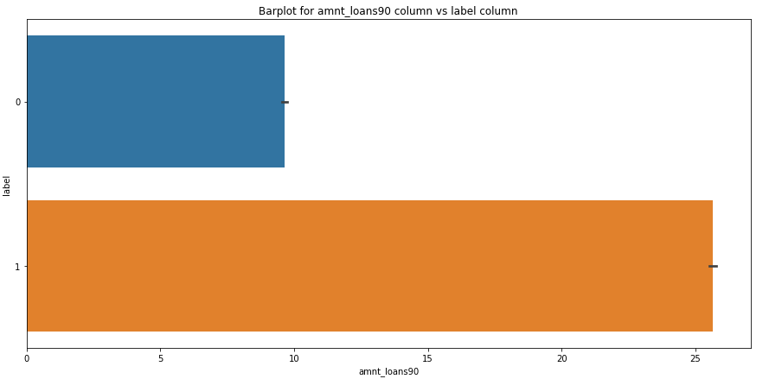
Visualizations: Bivariate Analysis
The total amount of loans taken by the defaulters in last 30 days are in the range of 7.5-10 while the non-defaulters have taken around 20 loans in last 30 days.
The total amount of loans taken by the defaulters in last 90 days are upto 10 and the non- defaulters have taken total amount of loans around 26 in last 90 days.
.

Slide 20
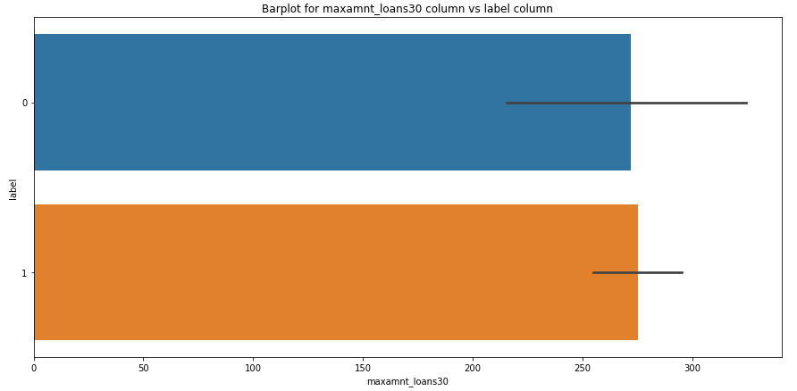
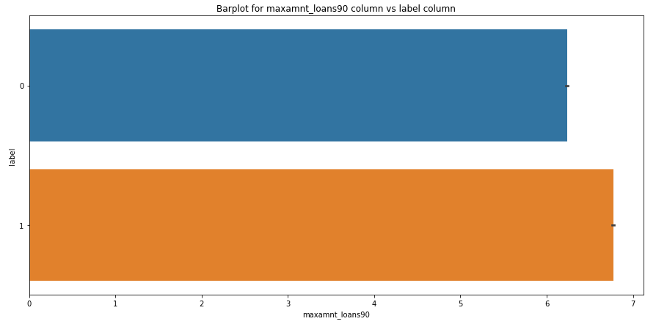
Visualizations: Bivariate Analysis
The maximum amount of loan taken by the user in last 30 days and 90 days are almost same. The maximum amount of loan taken by the defaulters and non-defaulters are up to 6 and 7 respectively in last 30 and 90 days.
So, from the plot we can say that whenever the user takes the maximum loan amount of 6, then only some users may not pay back the loan amount.
.

Slide 21
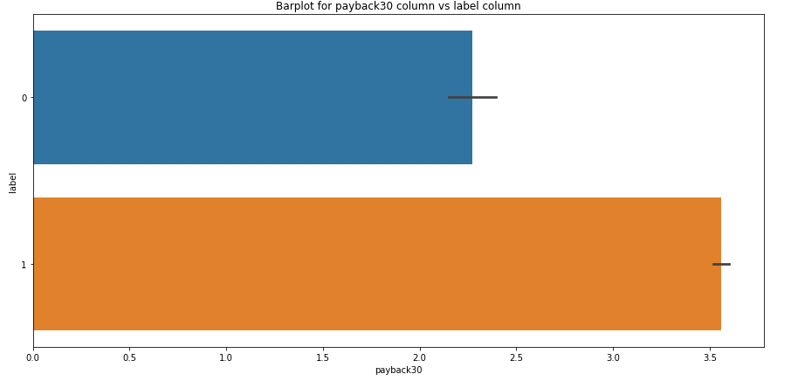
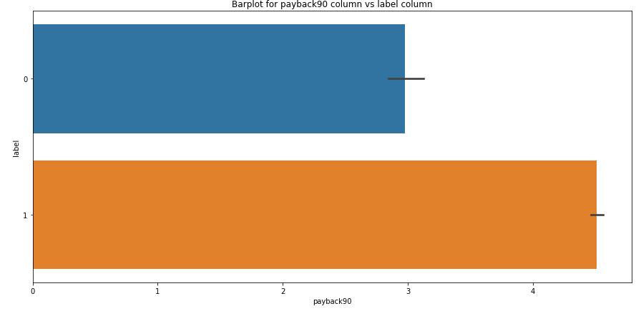
Visualizations: Bivariate Analysis
The defaulters are paying back their loan in an average of 2-2.5 days and the non-defaulters are paying back their loan in an average of 3 days over last 30 days.
The defaulters in last 90 days, are paying back their loan in an average of 3 days and non-defaulters are paying back their loan in 4-5 days over last 90 days.
.

Slide 22
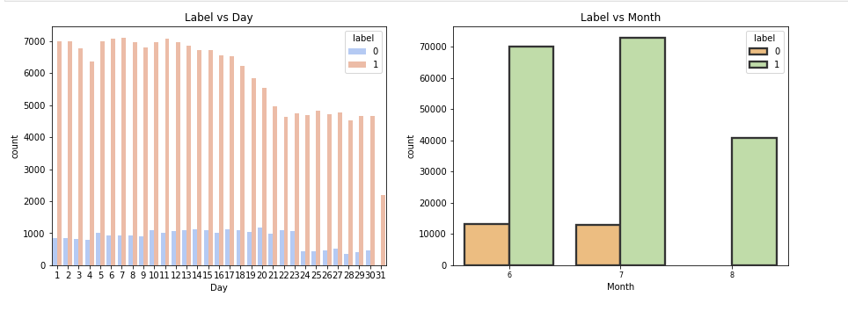
Visualizations: Bivariate Analysis
The users who have taken loans in the month of august, they seem paying back their loan within 5 days..

Slide 23
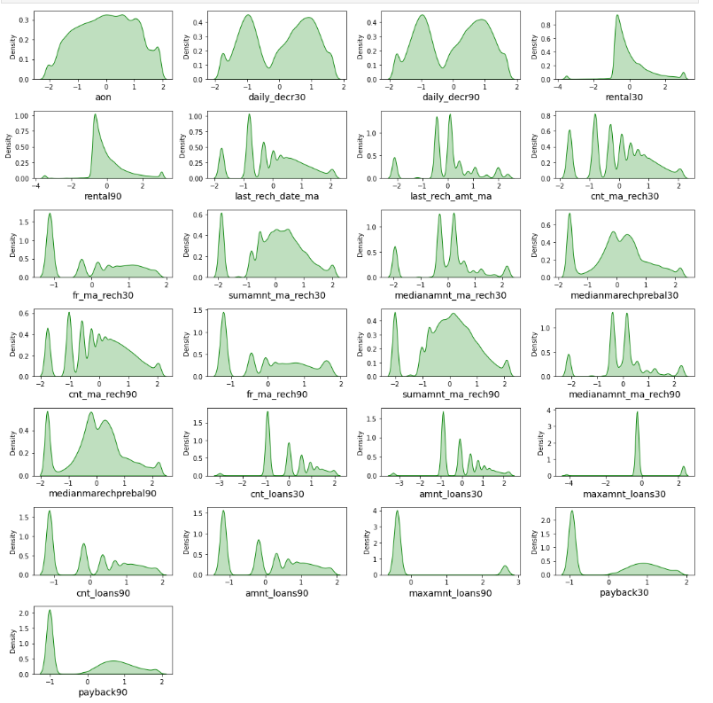
Data After Removing Outliers
This is the data after removing skewness using power transformations methods, respectively. The data looks almost normal.

Slide 24
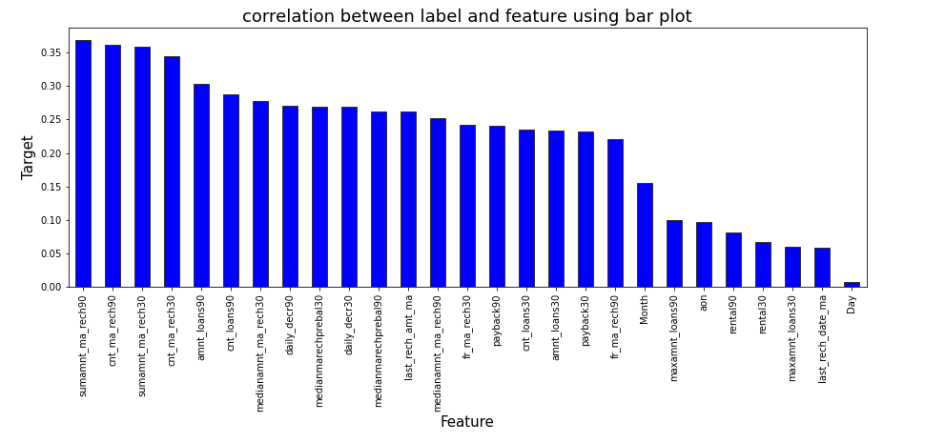
Correlation Between Features and Label
From the bar plot we can clearly observe the positive correlation between the label and features. Here Total amount of recharge in main account over last 30 days is highly correlated with label compared to other features and the column Day is less correlated with the label compared to others .

Slide 25
Data Analysis Steps done
I have done feature engineering steps like feature extraction and feature selection to improve data normality and linearity.
Identified outliers using boxplots and removed outliers using percentile method.
Identified skewness using distribution plots and removed skewness using power transformation method (yeo-johnson method).
Used Pearson’s correlation coefficient to check the correlation between dependent and independent variables. To visualize the correlation I have used heatmap and bar plot.
I have used Standard Scalar method to scale the data to overcome with the issue of data biasness.
Balanced the data using SMOTE oversampling mechanism.
Split train and test to build machine learning models. Model building process will be shown in the further steps.

Slide 26
Assumptions:
Firstly, from the problem statement we got to know that it is a Classification type problem for which we will be using Classification algorithms to build the model and predict the defaulters level.
Secondly, from the distribution plots and box plots I found skewness and outliers in almost all the columns. Also, based upon the analysis and visualization part we have seen some of the features having linear relation with label. So, I assumed these features helps in model building and to predict the defaulters and non-defaulters level in the organizations. Also, it helps the loan providing companies to give loan to the people who do not have sufficient credit history based on these features.
So, I suggest that the financial institutions take into consideration the features that were deemed as most important as seen in this study might help them estimate the defaulter's level.

Slide 27
Model Building:
In this problem label is our target variable which is categorical in nature that is the Label ‘1’ indicates that the loan has been paid i.e., “non-defaulter”, while, Label ‘0’ indicates that the loan has not been paid i.e., “defaulter”. From this I can conclude that it is a Classification type problem hence I have used following regression algorithms.
After the pre-processing and data cleaning with the help of feature importance bar graph I used the independent features for model building and prediction. The algorithms used on training the data are as follows:
Decision Tree Classifier
Random Forest Classifier
Extra Trees Classifier
Gradient Boosting Classifier
Bagging Classifier
Extreme Gradient Boosting Classifier (XGB)
I have got the best ransom state and then created train test split to build the above models.

Slide 28
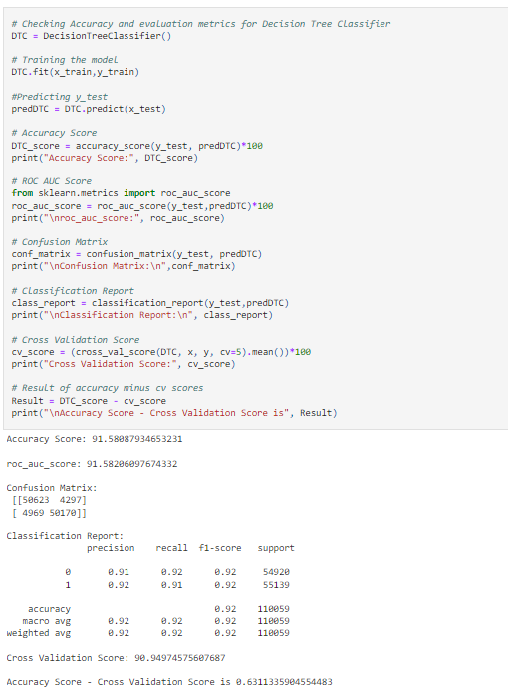
Decision Tree Classifier
Created Decision Tree Classifier model and checked for its evaluation metrics and it is giving accuracy as 91.58%.

Slide 29
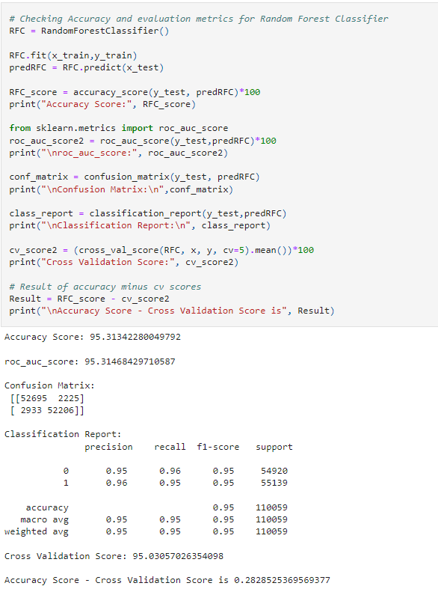
ii. Random Forest Classifier:
Created Random Forest Classifier model and checked for its evaluation metrics. The model giving accuracy as 95.31%.

Slide 30
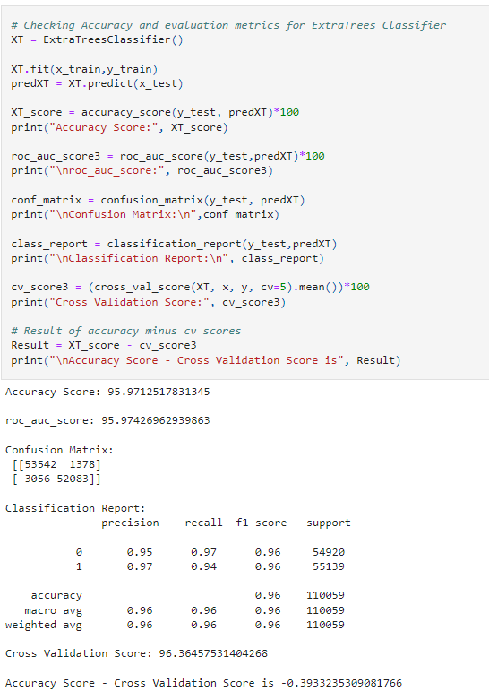
iii. Extra Trees Classifier:
Created Extra Trees Classifier model and checked for its evaluation metrics. The model giving accuracy as 95.97%.

Slide 31
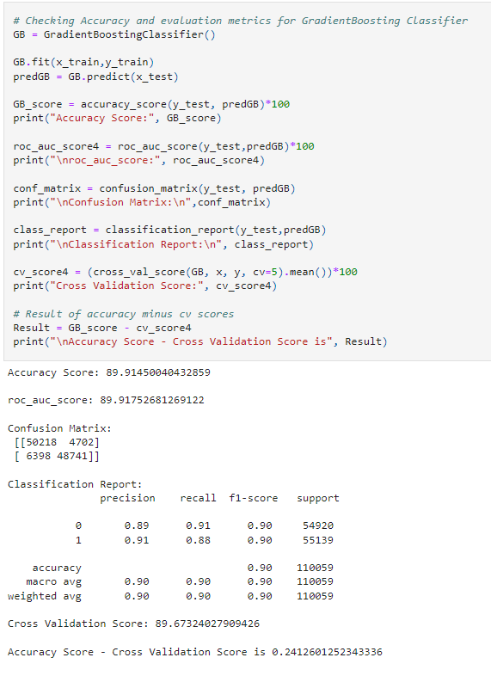
iv. Gradient Boosting Classifier:
Created Gradient Boosting Classifier model and checked for its evaluation metrics. The model giving accuracy as 89.91%.

Slide 32
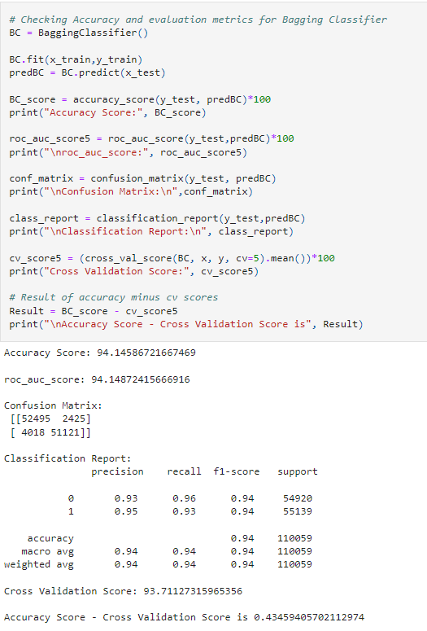
v. Bagging Classifier:
Created Bagging Classifier model and checked for its evaluation metrics. The model giving accuracy as 94.14%.

Slide 33
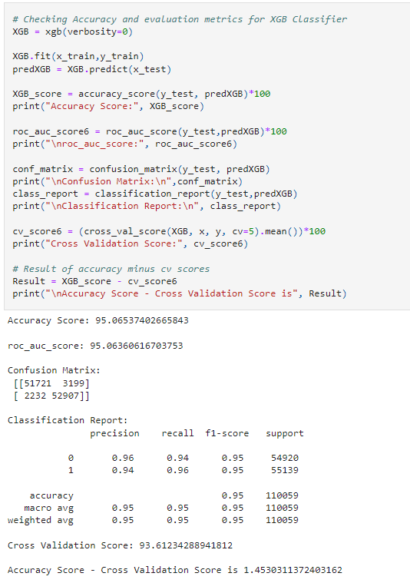
vi. Extreme Gradient Boosting Classifier (XGB):
Created Extreme Gradient Boosting Classifier model and checked for its evaluation metrics. The model giving accuracy as 95.06%.

Slide 34
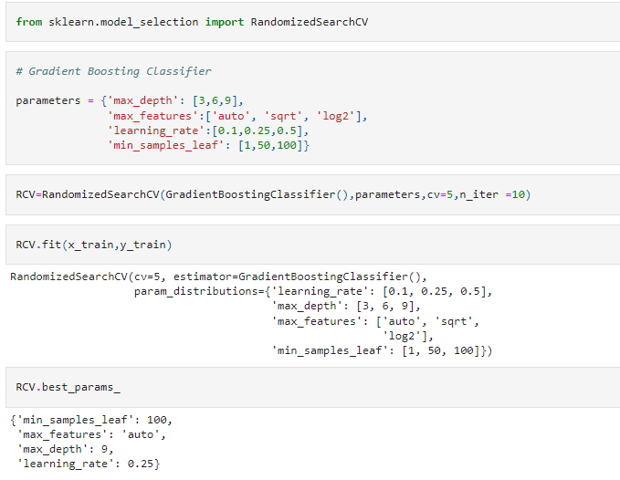
Hyperparameter Tuning:
From the difference between accuracy and cross validation score, Gradient Boosting Classifier has least difference compared to other models. So, we can conclude that Gradient Boosting Classifier as our best fitting model. Performed Hyperparameter tuning to increase the best model accuracy.
I have used RandomizedSearchCV to get the best parameters of Gradient Boosting Classifier. And used all the obtained best parameters to create the accuracy of final model.

Slide 35
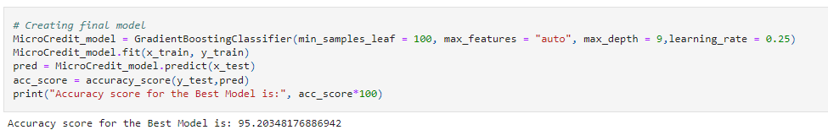
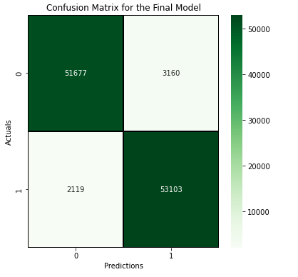
Creating Final Model After Tuning:
I have successfully incorporated the hyper parameter tuning using best parameters of Gradient Boosting Classifier and the accuracy of the model has been increased by 5% after hyperparameter tuning and received the accuracy score as 95.20% which is very good.
With the help of confusion matrix we can be able to see actual and predicted values for the final model. And also, we can understand the number of times we got the correct outputs and the number of times my model missed to provide the correct prediction

Slide 36
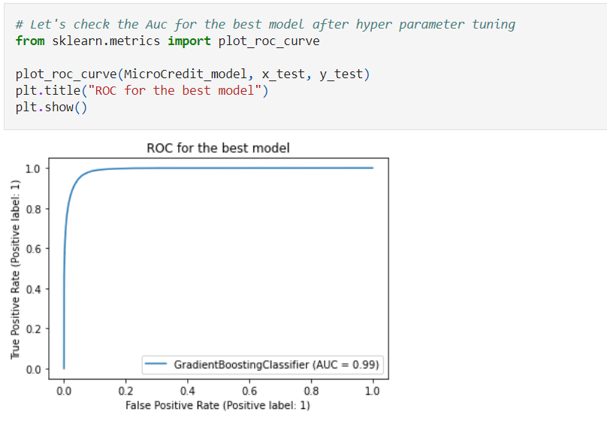
ROC-AUC Curve for all the models and for the best model:
ROC-AUC Curve for final model
I have generated the ROC Curve for the final model and compared with AUC. The AUC score for my final model to be of 99% which is increased after tuning the model as it can be observed from the curves.

Slide 37
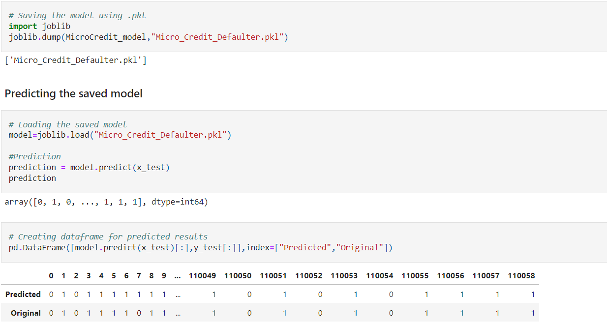
Saving The Final Model And Predictions From Saved Model
I have saved my final best model using joblib library in .pkl format, and loaded saved model for predictions.
Using classification model, we have got the predicted values for micro credit loans for defaulters and non-defaulters. From the predictions we can notice both actual values and predicted values are almost same.

Slide 38
Conclusion:
Key Findings and Conclusions of the Study: From the final model MFI can find if a person will return money or not and should a MFI provide a load to that person or not judging from the various features taken into consideration.
Learning Outcomes of the Study in respect of Data Science: I built multiple classification models and did not rely on one single model for getting better accuracy and using cross validation comparison I ensured that the model does not fall into overfitting and underfitting issues. I picked the best one and performed hyper parameter tuning on it to enhance the scores.

Slide 39
Limitations of this work and Scope for Future Work
Limitation is it will only work for this particular use case and will need to be modified if tried to be utilized on a different scenario but on a similar scale.
Scope is that we can use it in companies to find whether we should provide loan to a person or not and we can also make prediction about a person buying an expensive service on the basis of there personal details that we have in this dataset like number of times data account got recharged in last 30 days and daily amount spent from main account, averaged over last 30 days (in Indonesian Rupiah) so even a marketing company can also use this.

Slide 40
Thank You

